Slide 1

Water Quality Prediction

Slide 2



Introduction
With the population and the ever increasing need for various resources ,we are faced with a dilemma on how to manage our lives. In a struggle to do that ,we sometimes end up utilizing a poor or contaminated source of water for our use and thus put our health on stake.
According to recent survey of World Health Organization(WHO), more than 2.2 billion people in India face problems due to unsafe drinking water and 21 % of the diseases are related to impure water.

Slide 3
Problem Statement
Safe and readily available water is important for public health, whether it is used for drinking, domestic use, food production or recreational purposes. Better water supplies and sanitation, as well as better management of water resources, can contribute greatly to poverty reduction and economic growth. It is known that contaminated water and inadequate sanitation facilitate the transmission of diseases such as cholera, diarrhoea, dysentery, hepatitis A, typhoid, and polio. Those without access to clean water and sanitation face preventable health risks

Slide 4
Objective
To understand what constitutes safe, potable water and distinguish between potable and non-potable water by applying machine learning techniques
The major goal of this project is to use machine learning techniques to measure water quality. A potability is a numerical phrase that is used to assess the quality of a body of water. The following water quality parameters were utilised to assess the overall water quality in terms of potability in this study. ph, Hardness, Solids,Chloramines, Sulfate, Conductivity, Organic Carbon, Trihalomethanes, Turbidity were the parameter.

Slide 5
DATASET
Proposed system is implemented using the water potability dataset from Kaggle. The water_potability.csv file contains water quality metrices for 3276 dataset,9 features and one target variable.
Features list are pH, Hardness, Solids, Chloramine, Sulfate, Conductivity, Organic Carbon, Trihalomethanes, Turbidity.
Potability is the target variable.
URL:https://www.Kaggle.com/datasets/water_potability

Slide 6
Working Model:
Libraries Used –
Pandas – Pandas is an open-source library in Python that is made mainly for working with relational or labeled data both easily and intuitively.
Numpy – To perform wide variety of mathematical operations on arrays.
Matplotib and Seaborn – For creating static, animated and interactive visualizations.
sklearn – Tool for predictive data analysis. Features various classification, regression and clustering algorithms.

Slide 7
Working Model:
Requirements:
Dataset that can contain relevant information.
Proper data visualization.
Selection of correct classification model.
Calculating the accuracy of the model.

Slide 8
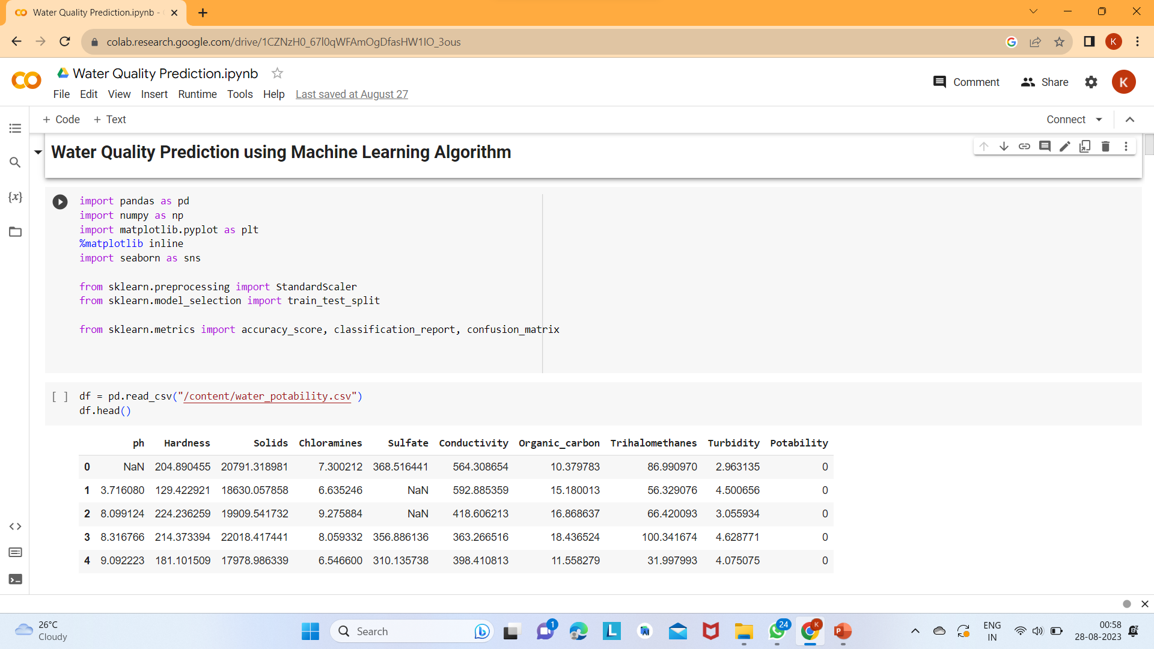
Importing the Libraries and dataset

Slide 9
Exploratory Data Analysis:
df.isnull().sum() : Checks for missing,null values in the dataset.
df.info() : Gives the information about datatype of the columns.
df.describe : Give the statistical values of the dataset.
Handling the missing values by filling it with the mean value of the attribute.

Slide 10
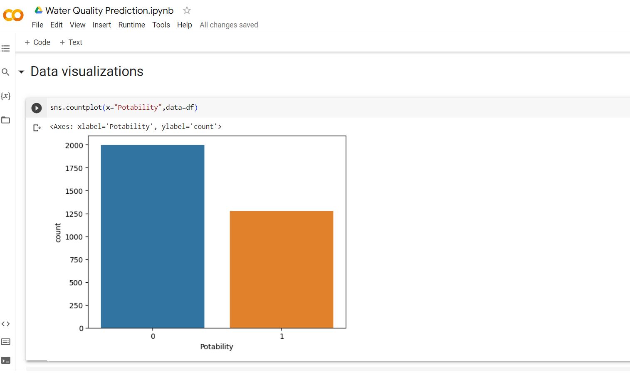
Data Visualizations:

Slide 11
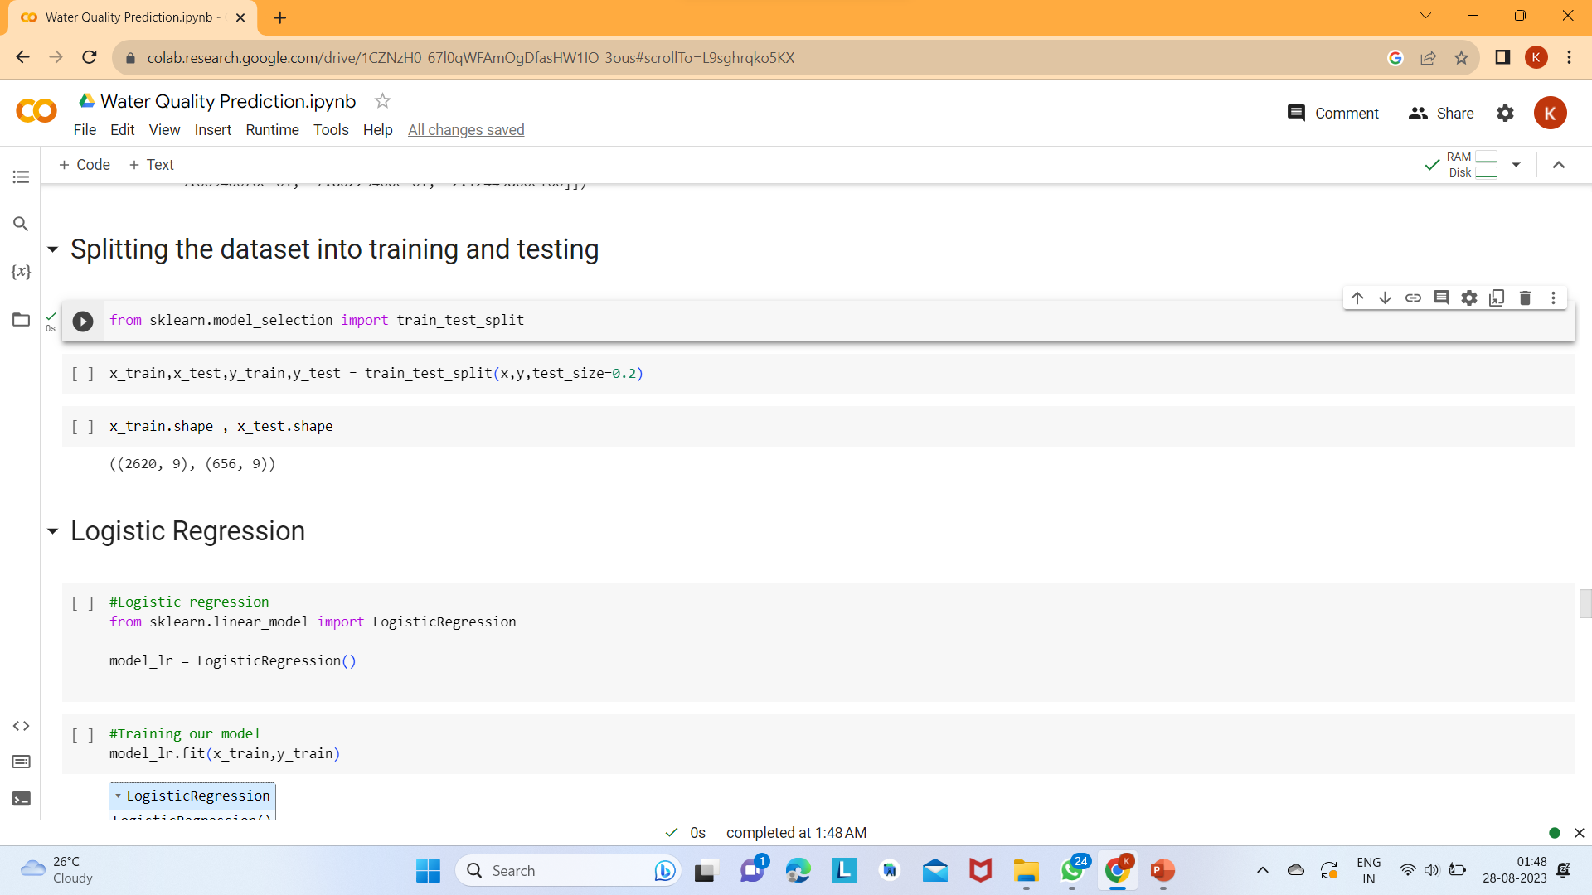
Splitting the datAset:

Slide 12
Algorithms:
We used different classication algorithms for train our model.
They are:
Logistic Regression
Decision Tree Classifier
Random Forest Classifier
SVM
KNN

Slide 13
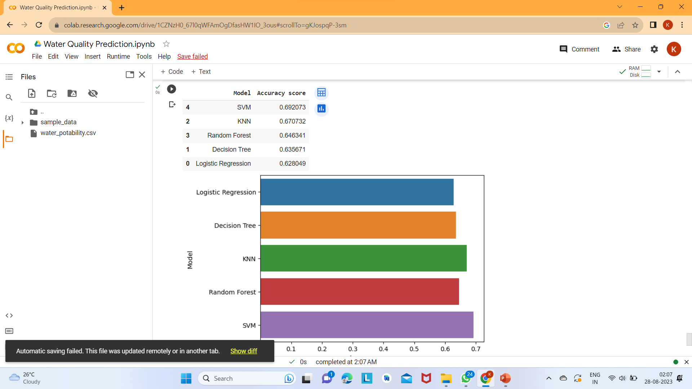
Comparison of the accuracy of the machine learning models:

Slide 14
Conclusion:
The project is meant to be replacement to the existing manual system of water testing as the existing system is very time consuming and includes human labour.
The machine learning algorithms have been used to design the water quality prediction model which predicts whether the water is safe for drinking or not.
After testing different algorithms, The Support Vector Machine is found to be the best performing model among all others in terms of accuracy with the percentage accuracy of 69.20% .

Slide 15



